Slide 1
The cay by
Theodore Taylor

Slide 2
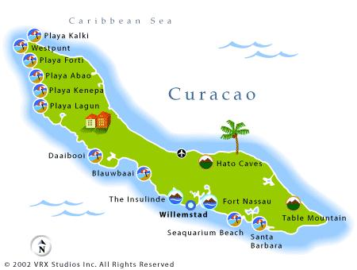
Setting
The novel is set in Willemstad on the island of Curacao, the largest of the Dutch islands just off the coast of Venezuela.

Slide 3
The story takes place during WWII. This is important background knowledge for understanding some of the situation in the plot and as well as some of the cultural norms about segregation.

Slide 4
Homework – History of Curacao
Complete the provided question sheet
You can use the following websites:
http://www.britannica.com/place/Curacao
http://www.curacao.nl/en/about-curacao/history-of-curacao/
Due on Thursday 28th April

Slide 5
New vocabulary within the novel
A cay: a low insular bank or reef of coral, sand, etc. (see island).
Superstition: an irrational fear of the unknown or mysterious.
Sextant: an instrument with a graduated arc of 60° used in navigation and surveying for measuring the angular distance of objects by means of mirrors.

Slide 6
New vocabulary within the novel
Refinery: a place where oil is refined
Channel:
U-boat: German submarine (unterseeboot: under-sea boat)
Ballast: any heavy material placed in a ship or the car of a ballon to secure stability
Freighter: ship or aircraft designed to carry freight.
4a: a person who consigns goods for carriage inland.

